Slide 1
Phenome-wide Association Study of Cystic Fibrosis Modifier Genes
Supervisor: Dr. Lisa Strug
Practicum Student: Faizan Khalid Mohsin

Slide 2



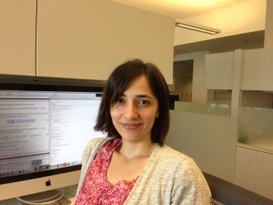

The Hospital for Sick Children
The Strug Lab
Lisa Strug, Ph.D
Naim Panjwani, M.Sc.
Zeynep Baskurt, Ph.D

Slide 3
Introduction Objective Background Methods Dataset Statistical Methods Results Discussion Challenges Conclusion and Limitations Future Work Synopsis
References Acknowledgements

Slide 4
Overview
Background: Cystic Fibrosis and Modifier Genes
Research Question
What is a PheWAS?
UK Biobank Database
Statistical Methodology and Results
Limitations and Challenges
Future Work

Slide 5
Introduction Background Objective

Slide 6
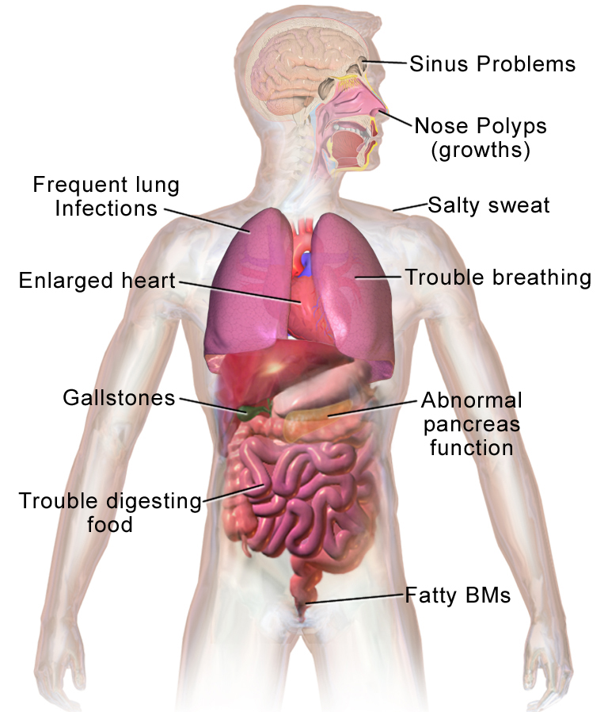
bACKGROUNd
Cystic Fibrosis
Cystic fibrosis (CF) is the most common fatal genetic disease affecting Canadian children and young adults. At present, there is no cure.
Commonly suffer from lung disease.
All physical and observable traits.
E.g. Height, hair color, white blood cell count, and diseases you may have (diabetes, cystic fibrosis, etc.).
Phenotype
Notes:
[1] Reference: Cystic Fibrosis Canada website
https://www.cysticfibrosis.ca/about-cf/what-is-cystic-fibrosis

Slide 7
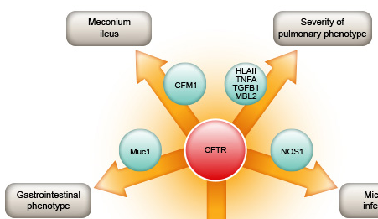
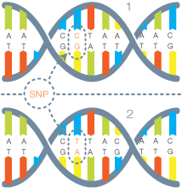
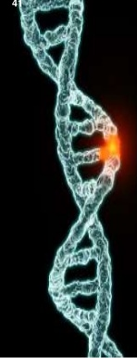
Modifier Genes
Modifier Gene
SLC26A9
RS4077468
Cystic Fibrosis (CF) Genetic modifiers are SNPs that affect the severity of the disease.
Modifier gene: SLC26A9
Affects lung function for people with CF.
SNP: RS4077468
SNP Variation:
AA
AT
TT
SLC26A9
SNP
A
A
SLC26A9 Gene
RS4077468
AA
AT
TT
A
T
Notes:
Reference image: http://www.cftr.info/about-cf/cftr-mutations/the-correlation-between-cftr-mutations-and-disease-severity/modifier-genes/
Some Modifier genes worsen the severity of disease. E.g. The presence of modifier genes could decrease the immune system, or cause increased mucus which increases lung infection. Hence, someone with a lung disease could experience much more sever symptoms. The modifier genes’ mechanism need not affect the disease directly to worsen it.
Everyone has these genes which effect the severity of the disease.
Multiple regression.

Slide 8
SNP: single nucleotide polymorphism
RS4077468
SNP
A
A
SLC26A9 Gene
RS4077468
AA
AT
TT
A
T
Notes:
Reference image: http://www.cftr.info/about-cf/cftr-mutations/the-correlation-between-cftr-mutations-and-disease-severity/modifier-genes/
Some Modifier genes worsen the severity of disease. E.g. The presence of modifier genes could decrease the immune system, or cause increased mucus which increases lung infection. Hence, someone with a lung disease could experience much more sever symptoms. The modifier genes’ mechanism need not affect the disease directly to worsen it.
Everyone has these genes which effect the severity of the disease.
Multiple regression.

Slide 9
Introduction Background Objective

Slide 10
In the general public what is the impact of variation in the three modifier genes on a person's phenotypes.
Research Question
We will answer this question through a Phenome-wide Association Study (PheWAS).
The 3 modifier genes of interest:
1) SLC26A9 (Chromosome 1 - SNP rs4077468 Substitute: rs4077469; r = 1)
2) SLC6A14 (Chromosome X – SNP rs3788766 Substitute: rs5905176; r = 0.770)
3) SLC9A3 (Chromosome 5 – SNP rs57221529 Substitute: rs17497684; r = 0.821)
Notes:
WHAT THEIR IMPACT is:
The 3 Modifier genes of interest: what phenotypeP these modifier genes effect
Which phenotypes are associated with the three modifier genes of interest in a non-cystic fibrosis population?
E.g.
Variability in response to a CFTR-directed therapy attributed to SLC26A9 genotype was assessed in Canadian patients with gating mutations. A primary airway model system determined if SLC26A9 shows modification of Phe508del CFTR function upon treatment with a CFTR corrector.
In those with gating mutations that retain cell surface-localized CFTR we show that SLC26A9 modifies lung function while this is not the case in individuals homozygous for Phe508del where cell surface expression is lacking.
Reference: Cystic fibrosis gene modifier SLC26A9 modulates airway response to CFTR-directed therapeutics
https://academic.oup.com/hmg/article/25/20/4590/2525897

Slide 11
Methods Dataset Statistical Methods

Slide 12
UK Biobank
Cohort
Approximately 500,000 people aged between 40-69 years in 2006-2010 from across the country (Mainly England, Scotland and Wales).
Initial enrollment took place over four years from 2006.
Baseline data collected via questionnaires, physical measures, sample assays, accelerometry and multimodal imaging among others.
Individual’s national health records have also been linked with their baseline and genotypic data.
1511 phenotypes obtained from ICD10 codes (30GB).
Genotype data (100GB). Micro arrays: between 500,000 to 1 million SNPs per person.
Significant time spent data cleaning (formatting, merging, etc.).
Notes:
References: introns and exons.
(UK) https://www.ukbiobank.ac.uk/about-biobank-uk/
(W) https://en.wikipedia.org/wiki/UK_Biobank
Made it publicly available to researchers ( not free)
. Micro arrays 500,000 ~ 1million SNPs per person, indels
*Though only people aged 40-69 years were recruited into the project, there is no upper age limit for participants.
Which measures are self report, which are clinically measured – bias?

Slide 13
Phecodes
The phecode system was built upon the International Classification of Diseases, Ninth Revision, Clinical Modification (ICD-9-CM) for phenome-wide association studies (Wu et al. 2018).
Purpose:
It was created for proper hierarchical grouping of phenotypes.
High throughput.
For ensuring exclusion of mutually exclusive phenotypes. For example, excluding subjects with any other type of diabetes from the control group when studying type 2 diabetes (Wei et al. 2017).
In general, phecodes have been successfully used in a number of PheWAS to replicate hundreds of known genetic associations and discovered new ones.

Slide 14
Data Flow Chart for SLC26A9 - SNP rs4077468)
Phenotypic data
(ICD10 data)
N = 349,590
Genotypic data
N = 488,377
Kinship analysis (removed people up to 2nd degree of relatedness)
Unrelated Individuals
N = 452,197
Ancestral PCA (removed non-Caucasian individuals)
Caucasians
N = 377,961
Merged phenotypic data from ICD10 codes with genotypic data
Final data
N = 263,607
Final data set for SCL9A3, SCL26A9 and SLC6A14
had individuals 262,923, 261,655 and 117,398, respectively.
Notes:
References: introns and exons.
(UK) https://www.ukbiobank.ac.uk/about-biobank-uk/
(W) https://en.wikipedia.org/wiki/UK_Biobank
Made it publicly available to researchers ( not free)
. Micro arrays 500,000 ~ 1million SNPs per person, indels
*Though only people aged 40-69 years were recruited into the project, there is no upper age limit for participants.
Which measures are self report, which are clinically measured – bias?

Slide 15
Methods Dataset Statistical Methods

Slide 16
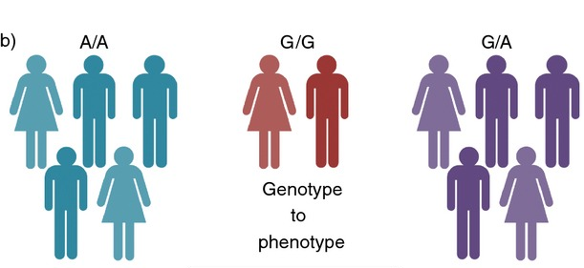
What is a PheWAS?
PheWAS: Phenome-Wide Association Study
Tests the association between genetic variants of interest with every phenotype measured.
They are cross-sectional studies.
The outcome variable is the person’s phenotype. The predictor variable is the allele variation of the SNP.
A/T
T/T
Association: genotype (G) → all phenotypes (P’s)
(Variation in the gene)
(Different Physical Traits such as colour blindness or genetic disease)
Notes:
Reference (Review paper):
The challenges, advantages and future of phenome-wide association studies
https://www.ncbi.nlm.nih.gov/pmc/articles/PMC3904236/
Phenotype
https://en.wikipedia.org/wiki/Phenotype

Slide 17
Phenome-Wide Association Study (PheWAS)
Statistical Method: Additive Model for performing PheWAS:
Logit( P(phenotype_i = 1) ) = SLC26A9_i + covariates_i i=1, …,1511 individual
0 if RS4077468_AA
Phenotype_i = 0 if do not have phenotype SLC26A9 = 1 if RS4077468_AT
2 if RS4077468_TT
Perform adjusted and unadjusted logistic regression.
Adjusted for covariates: Age, age-squared and sex.
Software:
R ("PheWAS/PheWAS" package from github) and PLINK.
Linux environment for high performance computing.
0 if do not have phenotype i
1 if have phenotype i
Notes:
Reference: If snp is aa, at or tt
Ancestral PCA: Principal Components Analysis (PCA) is a fast, nonparametric method of detecting structure in data. When applied to genetic data, it separates major axes of ancestry, which separates samples based on population genetic structure. Differentiates people with different lineages. We only have snp info in the model. And this can be a confounder. Ref:PCAdmix: Principal Components-Based Assignment of Ancestry along Each Chromosome in Individuals with Admixed Ancestry from Two or More Populations: https://www.ncbi.nlm.nih.gov/pmc/articles/PMC3740525/
MINOR ALLELE TT
T minor allele
pValue in a snp
χ2 and t-tests.
Proportional odds models, all kinds of things
R PheWAS: data analysis and plotting tools for phenome-wide association studies in the R environment
https://www.ncbi.nlm.nih.gov/pmc/articles/PMC4133579/
Tree based Methods (Random Forest, etc.)? Perhaps?

Slide 18
Results Gene SLC9A3 (Chromosome 5) – SNP rs57221529 Gene SLC6A14 (Chromosome X) – SNP rs3788766 Gene SLC26A9 (Chromosome 1) - SNP rs4077468

Slide 19
SLC9A3 (Chromosome 5 – SNP rs57221529 Substitute: rs17497684; r = 0.821)
Bonferroni correction
α = 0.05

Slide 20
SLC9A3 (Chromosome 5 – SNP rs57221529 Substitute: rs17497684; r = 0.821)
Esophagitis, GERD and related diseases
OR = 1.064
P-value = 1.79E-06
Cases = 19,687
Controls = 243,236

Slide 21
Results Gene SLC9A3 (Chromosome 5) – SNP rs57221529 Gene SLC6A14 (Chromosome X) – SNP rs3788766 Gene SLC26A9 (Chromosome 1) - SNP rs4077468

Slide 22
SLC6A14 (Chromosome X – SNP rs3788766 Substitute: rs5905176; r = 0.770) for Males.
Bonferroni correction
α = 0.05

Slide 23
SLC6A14 (Chromosome X – SNP rs3788766 Substitute: rs5905176; r = 0.770) for Males.
Urinary Obstruction
OR = 1.68
P-value = 4.24E-05 Cases = 64
Controls = 117,334

Slide 24
SLC6A14 (Chromosome X – SNP rs3788766 Substitute: rs5905176; r = 0.770) for Females.
Bonferroni correction
α = 0.05

Slide 25
SLC6A14 (Chromosome X – SNP rs3788766 Substitute: rs5905176; r = 0.770) for Females.

Slide 26
Results Gene SLC9A3 (Chromosome 5) – SNP rs57221529 Gene SLC6A14 (Chromosome X) – SNP rs3788766 Gene SLC26A9 (Chromosome 1) - SNP rs4077468

Slide 27
SLC26A9 (Chromosome 1 - SNP rs4077468 Substitute: rs4077469; r = 1)
Manhattan Plot for SLC26A9 & rs4077469 without Covariates
Manhattan Plot for SLC26A9 & rs4077469 with Covariates
Bonferroni correction
α = 0.05

Slide 28
Discussion Challenges and Limitations Conclusion Future Work

Slide 29
Some Challenges and Limitations.
Multiple testing.
1511 phenotypes and three SNP’s
Missing data (phenotype & genotype). All and any missing data was deleted. Most likely data not MCAR; people with ICD9 codes were deleted. Mostly people in the beginning of the recruitment period.
No exclusion scheme when defining controls based on ICD codes.
Converting ICD10 codes to phenotypic codes (phecode system built was on ICD9 codes) Validated by Wu et al (2018) on the UKBB data.
Several phecodes and phynotypes are related, hence Bonferroni correction is conservative.
Relatedness, kinship analysis.
Computing the ancestral PCA.
Implementing all of this in a HPF.
Notes:
Reference (Review paper):
The challenges, advantages and future of phenome-wide association studies
https://www.ncbi.nlm.nih.gov/pmc/articles/PMC3904236/
Contrived phenotypes.
Pcomponents
Estimate kinship coefficients.
3rd degree, delete 1st cousins.
But even if case groups are large enough for regression analysis, standard variables such as age and sex may be inappropriate to implement within a regression model.
Small numbers of cases for many phenotypes may restrict analyses to contingency table tests of independence (e.g. Fisher’s exact test) precluding the use of covariates. ( may or may not happen, most likely not an issue for us).
Pleiotropic study: multilinear regression.
Phenome-Wide Association Studies as a Tool to Advance Precision Medicine
https://www.ncbi.nlm.nih.gov/pmc/articles/PMC5480096/

Slide 30
Conclusion
Results suggest that there maybe an association between gene SLC9A3 near SNP rs57221529, and having Esophagitis, GERD and related diseases.
Every additional C allele increases the odds by about 6.4% of having the related diseases in an individual.
Results generalizable to people with Caucasian ancestry.
With this PheWAS we may have found a phenotype associated with gene SCL9A3 in the non-CF population
However, further research work is required.
Notes:
Reference (Review paper):
The challenges, advantages and future of phenome-wide association studies
https://www.ncbi.nlm.nih.gov/pmc/articles/PMC3904236/
Contrived phenotypes.
Pcomponents
Estimate kinship coefficients.
3rd degree, delete 1st cousins.
But even if case groups are large enough for regression analysis, standard variables such as age and sex may be inappropriate to implement within a regression model.
Small numbers of cases for many phenotypes may restrict analyses to contingency table tests of independence (e.g. Fisher’s exact test) precluding the use of covariates. ( may or may not happen, most likely not an issue for us).
Pleiotropic study: multilinear regression.
Phenome-Wide Association Studies as a Tool to Advance Precision Medicine
https://www.ncbi.nlm.nih.gov/pmc/articles/PMC5480096/

Slide 31
Future Work
Instead of using additive model to perform the PheWAS, use a genotypic model (treat allele count as categorical variable).
Included interaction term between allele count and sex.
Use curated phenotypic data
Lung function: FEV1/FVC ratio
Validating the UKBB data, our data cleaning and conversion of ICD-10 to phecodes process and our PheWAS analysis, by replicating previously published PheWAS studies.
Notes:
Reference (Review paper):
The challenges, advantages and future of phenome-wide association studies
https://www.ncbi.nlm.nih.gov/pmc/articles/PMC3904236/
Contrived phenotypes.
Pcomponents
Estimate kinship coefficients.
3rd degree, delete 1st cousins.
But even if case groups are large enough for regression analysis, standard variables such as age and sex may be inappropriate to implement within a regression model.
Small numbers of cases for many phenotypes may restrict analyses to contingency table tests of independence (e.g. Fisher’s exact test) precluding the use of covariates. ( may or may not happen, most likely not an issue for us).
Pleiotropic study: multilinear regression.
Phenome-Wide Association Studies as a Tool to Advance Precision Medicine
https://www.ncbi.nlm.nih.gov/pmc/articles/PMC5480096/

Slide 32
Questions?

Slide 33
Additional Slides

Slide 34
Phenome-Wide Association Study (PheWAS)
Statistical Method: “Genotypic” Model for performing PheWAS:
Logit(Phenotype_i) = intercept + I(RS4077468_AT) + I(RS4077468_TT) + covariates
0 if RS4077468_AA (reference)
i=1, …,1511 , SLC26A9 = 1 if RS4077468_AT
2 if RS4077468_TT
Perform adjusted and unadjusted logistic regression.
Adjusted for covariates: Age, age-squared and sex.
Software:
R ("PheWAS/PheWAS" package from github) and PLINK.
Linux environment for high performance computing.
Notes:
Reference: If snp is aa, at or tt
Ancestral PCA: Principal Components Analysis (PCA) is a fast, nonparametric method of detecting structure in data. When applied to genetic data, it separates major axes of ancestry, which separates samples based on population genetic structure. Differentiates people with different lineages. We only have snp info in the model. And this can be a confounder. Ref:PCAdmix: Principal Components-Based Assignment of Ancestry along Each Chromosome in Individuals with Admixed Ancestry from Two or More Populations: https://www.ncbi.nlm.nih.gov/pmc/articles/PMC3740525/
MINOR ALLELE TT
T minor allele
pValue in a snp
χ2 and t-tests.
Proportional odds models, all kinds of things
R PheWAS: data analysis and plotting tools for phenome-wide association studies in the R environment
https://www.ncbi.nlm.nih.gov/pmc/articles/PMC4133579/
Tree based Methods (Random Forest, etc.)? Perhaps?

Slide 35
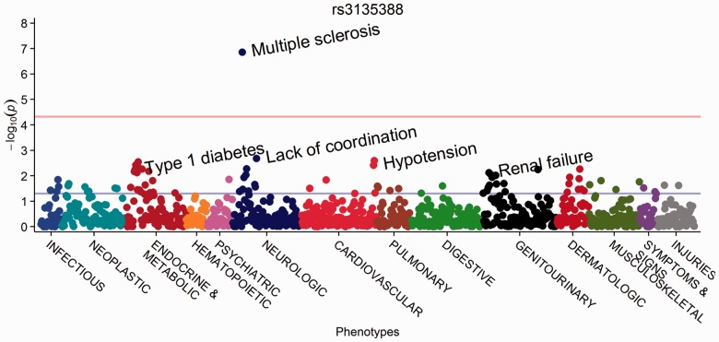
PheWAS Manhattan Plot
Genotype
Bonferroni correction
α = 0.05
Figure 5. PheWAS Manhattan plot for rs3135388, with phenotypes ordered by PheWAS code. (Carrol et al. 2014)
Notes:
Reference:
R PheWAS: data analysis and plotting tools for phenome-wide association studies in the R environment
https://www.ncbi.nlm.nih.gov/pmc/articles/PMC4133579/

Slide 36
Detailed Results for Multivariable Analysis.

Slide 37
SLC9A3 (Chromosome 5 – SNP rs57221529 Substitute: rs17497684; r = 0.821)
phecode | description | group | snp | beta | SE | OR | p | type | n_total | n_cases | n_controls | HWE_p | allele_freq | n_no_snp | bonferroni
530.1 | Esophagitis, GERD and related diseases | digestive | rs17497684_C | 0.062196 | 0.013023 | 1.064171 | 1.79E-06 | logistic | 262923 | 19687 | 243236 | 0.087651 | 0.195803 | 684 | TRUE
530 | Diseases of esophagus | digestive | rs17497684_C | 0.059461 | 0.012569 | 1.061265 | 2.23E-06 | logistic | 262923 | 21330 | 241593 | 0.087651 | 0.195803 | 684 | TRUE

Slide 38
SLC6A14 (Chromosome X – SNP rs3788766 Substitute: rs5905176; r = 0.770) for Males.
phecode | description | group | snp | beta | SE | OR | p | type | n_total | n_cases | n_controls | HWE_p | allele_freq | n_no_snp | bonferroni
599.1 | Urinary obstruction | genitourinary | rs5905176_G | 0.518311 | 0.126602 | 1.679189 | 4.24E-05 | logistic | 117398 | 64 | 117334 | 1 | 0.326198 | 194 | TRUE

Slide 39
Diseases
Gastroesophageal reflux disease, or GERD, is a digestive disorder that affects the lower esophageal sphincter (LES), the ring of muscle between the esophagus and stomach. Many people, including pregnant women, suffer from heartburn or acid indigestion caused by GERD.
Esophagitis (uh-sof-uh-JIE-tis) is inflammation that may damage tissues of the esophagus, the muscular tube that delivers food from your mouth to your stomach.Esophagitis can cause painful, difficult swallowing and chest pain.

Slide 40
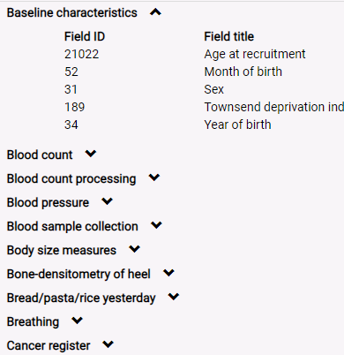
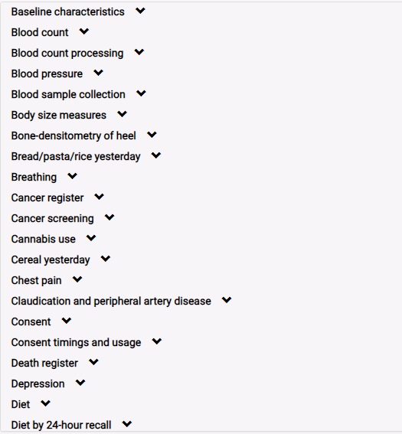
UK Biobank (Variables)
Notes:
References:
(UK) https://www.ukbiobank.ac.uk/about-biobank-uk/
(W) https://en.wikipedia.org/wiki/UK_Biobank
Which measures are self report, which are clinically measured – bias?

Slide 41
SLC26A9
SLC26A9

Slide 42
Table 1: Genes with the original and substitute SNP’s and their
correlation.
Gene SNP of Interest Chromosome Substitute SNP Correlation
SCL26A9 rs4077468 Chromosome 1 rs4077469 r = 1
SCL9A3 rs57221529 Chromosome 5 rs17497684 r = 0.821
SLC6A14 rs3788766 Chromosome X rs5905176 r = 0.770

